Slide 1
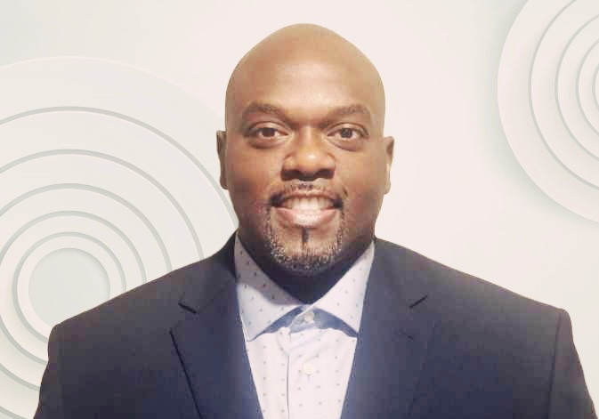
Tamares Cockfield
Career and Academic Advisor

Slide 2

Capstone Focus
Capstone Overview
Project Description:
Men of Color Collective’s (MCC) primary focus is to increase persistence, retention, and graduation rates for men of color, as well as provide a program of student support that strategizes to close achievement gaps for Black and Hispanic students, many of whom are considered first generation and low-income students.
Rationale: To provide student support that focuses on academic, professional, and student development through academic advising and programs in an effort to close existing achievement gaps among TCC’s male students of color.

Slide 3
Capstone Results
Data Snapshot - Fall 2022
Enrollment: 525
Designated an academic advisor for the Men of Color Collective. The advisor was assigned to send out communication and messaging to each student, as well as provided priority registration to those in the Collective.
  The cohort was able to register before registration opened to the general population of students.
Employed peer advisors to help with student engagement.
Black | Hispanic
Total Enrollment: 311 Good Academic Standing: 48% In Academic Recovery: 52% | Total Enrollment: 214 Good Academic Standing: 67% In Academic Recovery: 33%
* Summer Enrollment down 4% and Fall 2023 enrollment down 2% compared to other advisor cohorts.
Provide more workshops
It makes me very happy
Helps me understand that people relate to my situation
Honestly couldn’t ask for more
Continually reaching out has helped
Be supportive and consistent
It’s already amazing
Student survey feedback

Slide 4
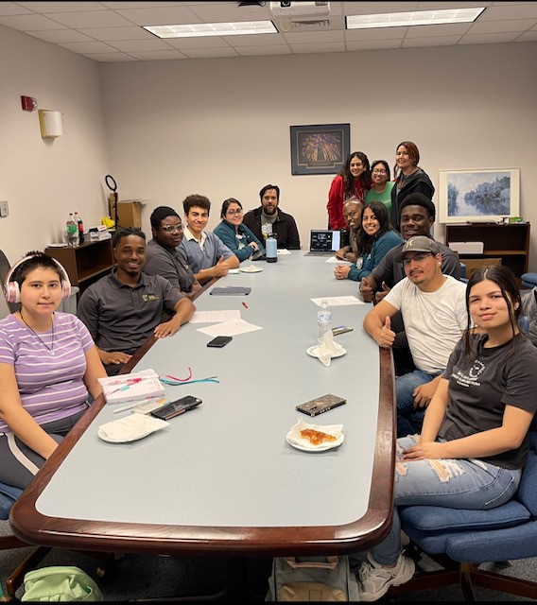
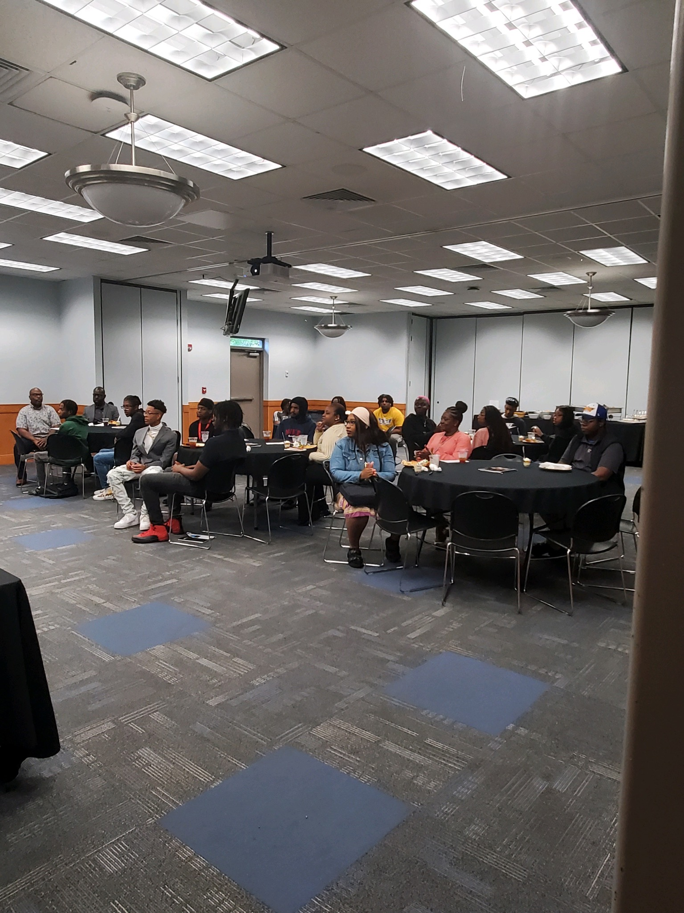
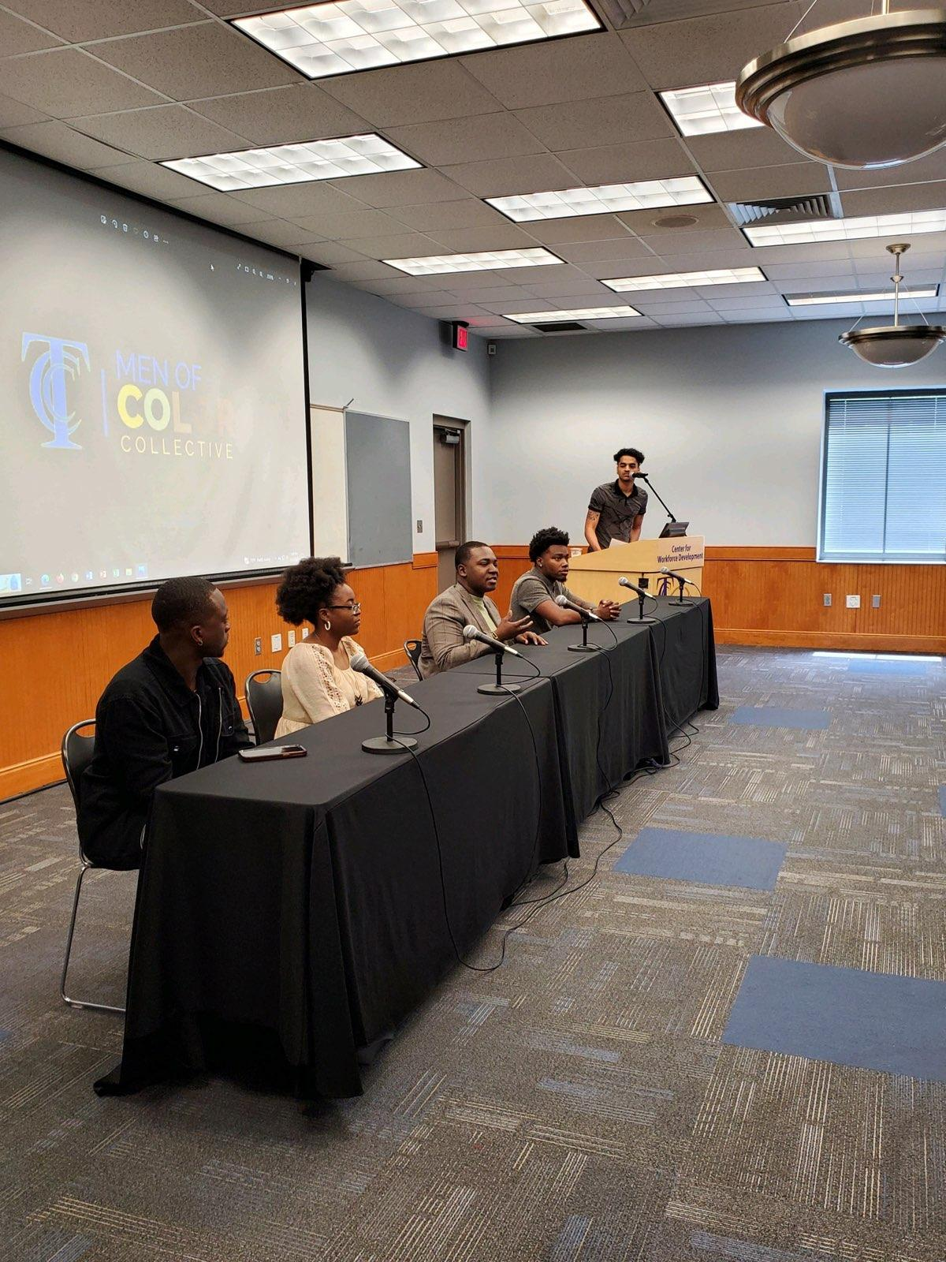
SUGGESTIONS FOR FURTHER RESEARCH
Recommendations Moving Forward
Continue strategizing different methods to improve Fall to Fall retention – Study Groups, Financial Literacy training delivered earlier.
Collaborate with other departments on campus to see how we can work together to meet the needs of students.
  Increase the likelihood of matriculation by providing coaching, mentorship, and financial literacy.

