Slide 1
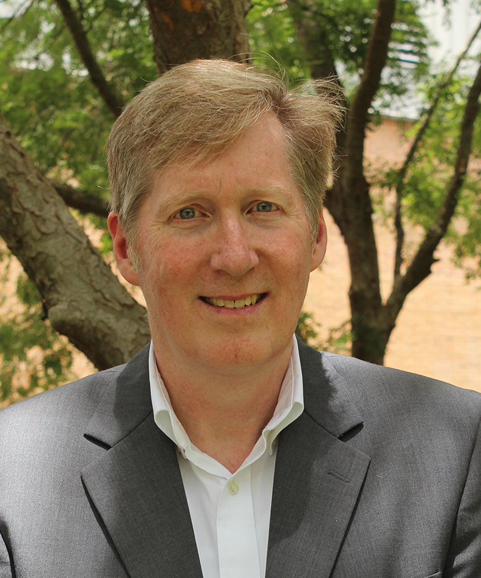
Stephen Banister
Director, Library Services

Slide 2
Assessment of Embedded Library Services
Project Overview: The study focuses on comparing student performance, success data, and faculty/student reported learning experiences across three different English II sections.
Each section had the same instructor, librarian, and information literacy lesson, but received instruction across a different modality: Asynchronous, Synchronous and Flipped classroom.
There will be Spring 2021 data collected and Fall 2021 data sampling.

Slide 3
Assessment of Embedded Library Services
Rationale: English faculty and librarian constantly face struggles with student engagement, quality of student performance on their research assignments, and lack of student preparation despite extraneous efforts on the parts of the faculty and librarian to engage students.
  Methods: Three sections of English II (ENC1102) courses taught by a TCC English faculty member (Constantio) with TCC Librarian. One section was Asynchronous, one section was Live Zoom, and one section was a flipped classroom using Live Zoom.
This study desires to explore and trial which learning modality will be most effect for students when other factors are controlled for: the instructor, librarian, lesson, class and day of the week.

Slide 4
Assessment of Embedded Library Services
Timeline: Initial assessment by end of Spring 2021. Second study to be conducted in Fall 2021 time frame.
Expected outcomes: Higher engagement with the librarian in the flipped classroom and asynchronous classroom environment.
Preliminary Results:
    a) Greatest success was in the online classroom. The data showed that the vast majority of students did well due to the greater presence of the librarian.
    b) Next successful classroom environment was the flipped classroom. The results showed slightly lower success rates with the students.
    c) The least successful format was the live Zoom class with the least exposure of students to presence of the TCC Librarian.

