Slide 1
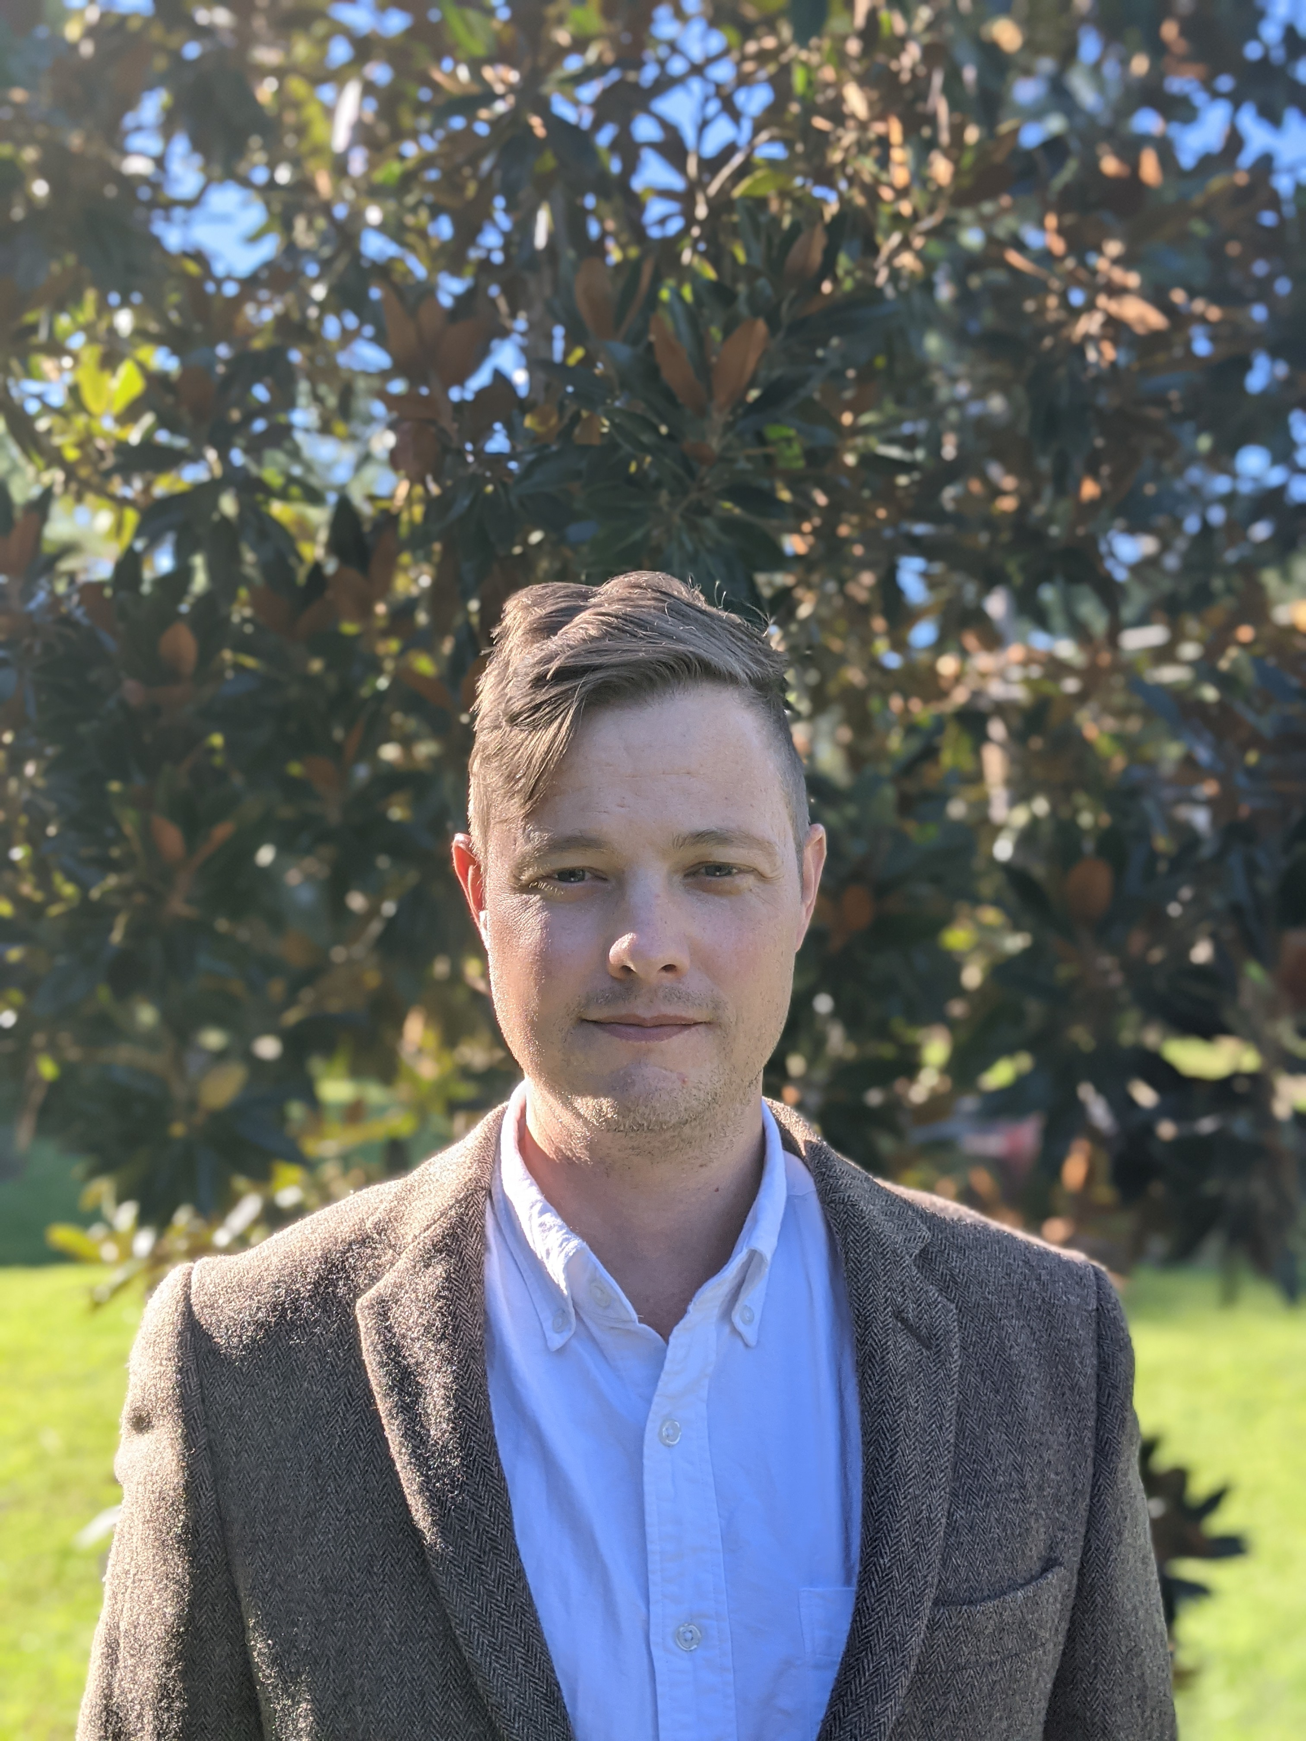
Ross Brooks
Professor, Mathematics

Slide 2
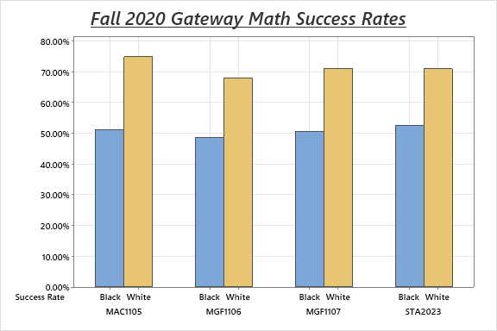
Capstone Focus
Capstone Overview: Mathematics Equity Workgroup
Project Description:
A concerned group of math faculty began working to research and implement strategies to narrow the equity gap in gateway math courses. Equity gap data in student success rates is being used to measure the efficacy of the project.
Rationale:

Slide 3
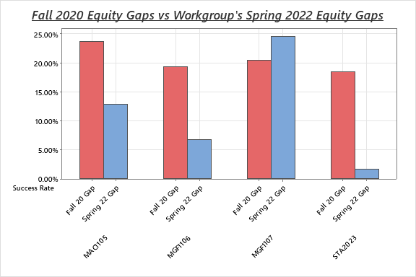
Capstone Focus
Capstone Results
Methodology:
Faculty in the workgroup implemented a variety of strategies based on a model of equity through C.A.R.E.
(Spring 2022: MAC1105 n = 121, MGF1106 n = 23, MGF1107 n = 255, STA2023 n = 46)
Visualizing the Change in Gaps:

Slide 4
SUGGESTIONS FOR FURTHER RESEARCH
Future Actions
Debriefing spring 2022 results
Researching fall 2022 strategies
Scaling initiatives
Notes:
It is impossible for a regional economy to achieve transformation unless there is a shared regional identity and a shared vision for regional economic growth that all the partners own – both as collective and individual partners. Partners will need to align the strategies and resources of their own organizations and systems to the regional vision.
The development of a regional identity (which is not necessarily a brand, but it can be) and the vision for regional economic growth are critical to sustaining a globally competitive region.
The vision is especially critical to driving new regional behavior and is the touchstone when a region faces challenges – something that is almost guaranteed given the wide array of interests that are represented in a regional economy.
The vision is also the driver for regional strategies and new investments, as well as for alignment of current investments.

