Slide 1
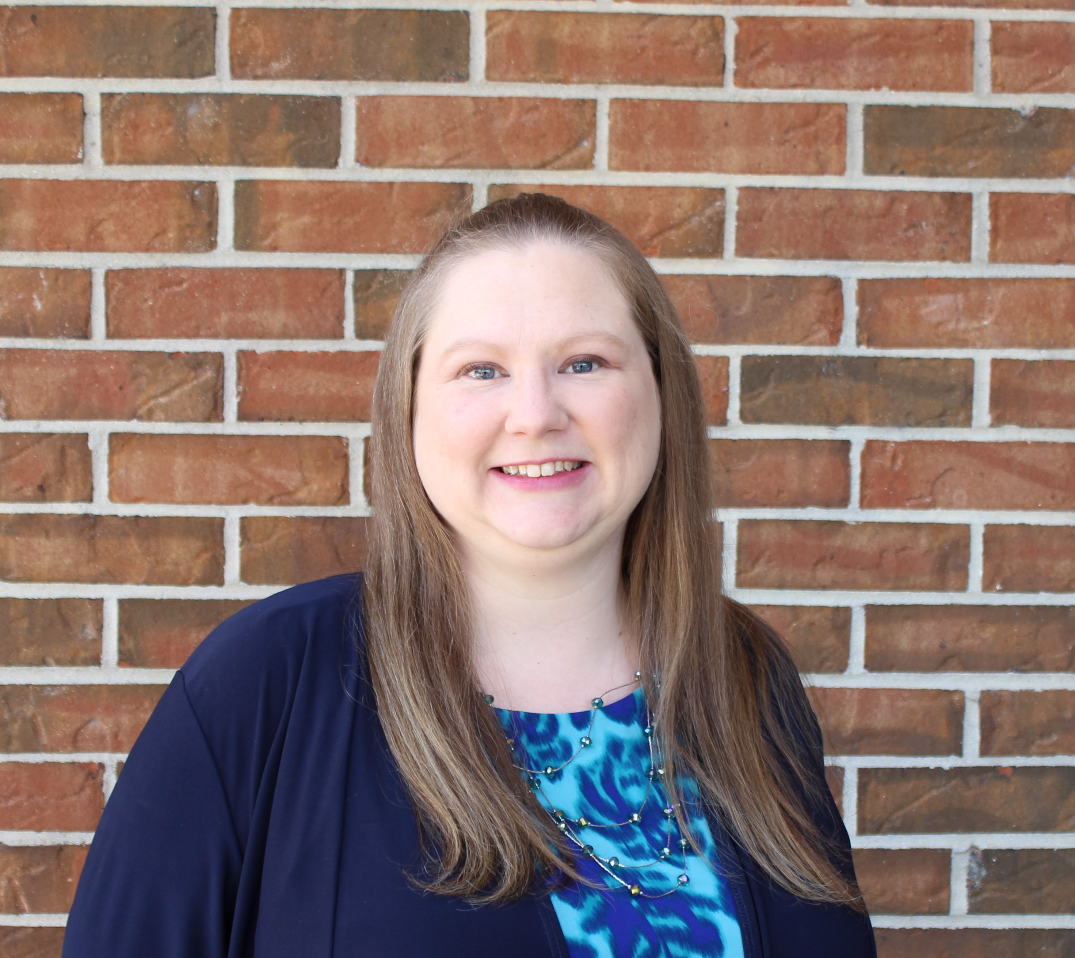
Melinda Rodgers
Dean, Enrollment Services and College Registrar

Slide 2
Capstone Focus
Capstone Overview
Workday Admissions Application: Improving the Student Experience
Track the student experience:
# of applications submitted
# of incomplete applications
# of false applicants
# of calls about application
equity minded focus on enrollment
residency completion
Identify and address barriers
Increase completed admissions files
Increase enrollment yield rate
Ensure minorities successfully complete the process

Slide 3
Capstone Results
Developed reports to track applicants
Reviewed applicant data for prior terms:
  The yield rate increased
  Applicant rates by race are similar
  Fewer Black applicants enroll
Enhanced communication plan to minority students
Utilized new tools to engage prospects
Case management model increased enrollment yield
Notes:
Track applicants by term based on applicant type, race, gender, etc. and admission file completion
Reviewed applicant data for Fall 2020, Spring 2021, Fall 2021 and Spring 2022: the yield rate increased 7% from Fall 2020 to Fall 2021

Slide 4
SUGGESTIONS FOR FURTHER RESEARCH
Suggestions for Further Research
Continue to monitor the enrollment funnel:
Fall 2022 | as of 5/3/2022
# of applications submitted | 6,051
# of incomplete applications | 2,830
# of false applicants | 94
# of calls about application | 278
residency completions | 5,487
Equity minded focus on enrollment
Race | # | Registrations
1-Black | 2,063 | 74
2-Hispanic | 1,174 | 104
3-White | 2,402 | 280
4-Other | 412 | 25
Total | 6,051 | 483
The final Fall 2022 data will be available on August 29th after the census date for the term.

