Slide 1

Margaret Bowman
Director, Transfer Services

Slide 2

Improving Transfer Efficiency
Adverse university admissions decisions due to high or “excess” credit hours
120% of degree (AA = 90)
Inconsistent transfer policies
Redundancy of college courses/credits
Seamless ~ Efficient ~ Engaging ~ Cost-effective
TSC
Project Description
Examine the transfer credit efficiency of FTIC students to: decrease excess credit hours increase university transfer rates eliminate frustration and confusion
TSC

Slide 3
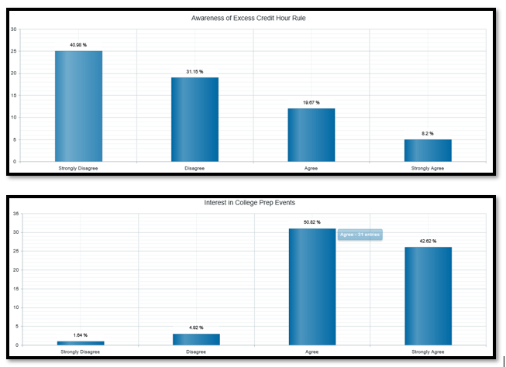
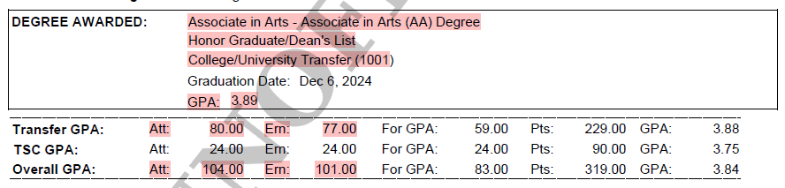
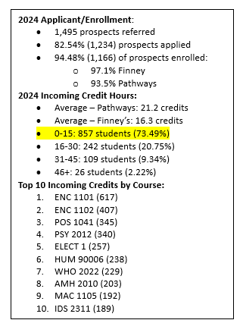
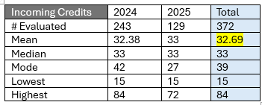
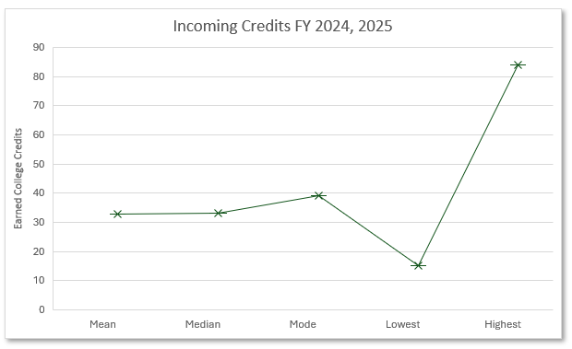
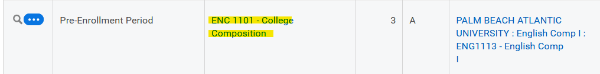
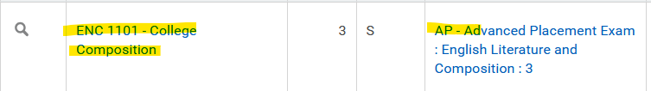
Capstone Results
FSU Pathways (Next)
Aspire Elite
Stakeholders:
Limited Awareness &
High Interest
HIGHER RISK
LOW RISK

Slide 4
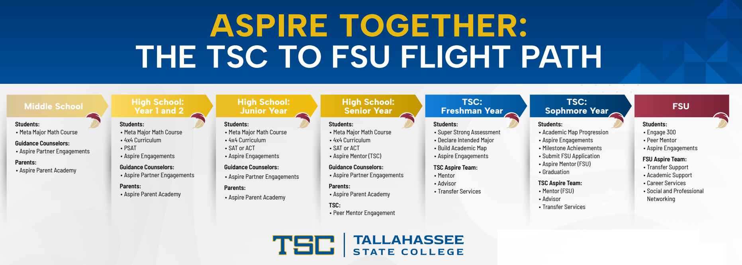

Future Recommendations
YEAR 1: BUILD AWARENESS
YEAR 1: BUILD AWARENESS

