Slide 1

Logan Lane
Director, Public Safety and Continuing Education, FPSI

Slide 2
Filling the Gap between Emergency Management Education and the Workforce
Project Description
In partnership with Florida’s Department of Emergency Management, the Florida Public Safety Institute will build out an Emergency Management Training Institution on the FPSI property located in Gadsden County.
Rationale:
  A study conducted by a group of researchers at Colorado State University reviewed the curriculum of 492 university and college degree programs. The study identified significant gaps with the Next Generation Core Competencies, for emerging accreditation standards for academic degrees, and emergency management workforce standards.
This project includes:
  Mass Staging and Storage Space
  Office, Classroom, and Emergency Operation
  Center for training and deployment
  Mass sleeping and bathroom facilities
  Realistic training facilities to include, Flood,
  Fire and Building Collapse events

Slide 3
Results
Course content is fragmented across disciplines
  Criminal Justice, Public Health, Homeland Security, Counter-Terrorism
Lack of alignment with workforce needs or accreditation
standards.
Raises critical questions about program consistency and
relevance.
Majority of programs do not adequately prepare students
for the emergency management workforce.
Programs offering only 0–15 credit hours in homeland security
or emergency management are insufficient for workforce readiness.

Slide 4
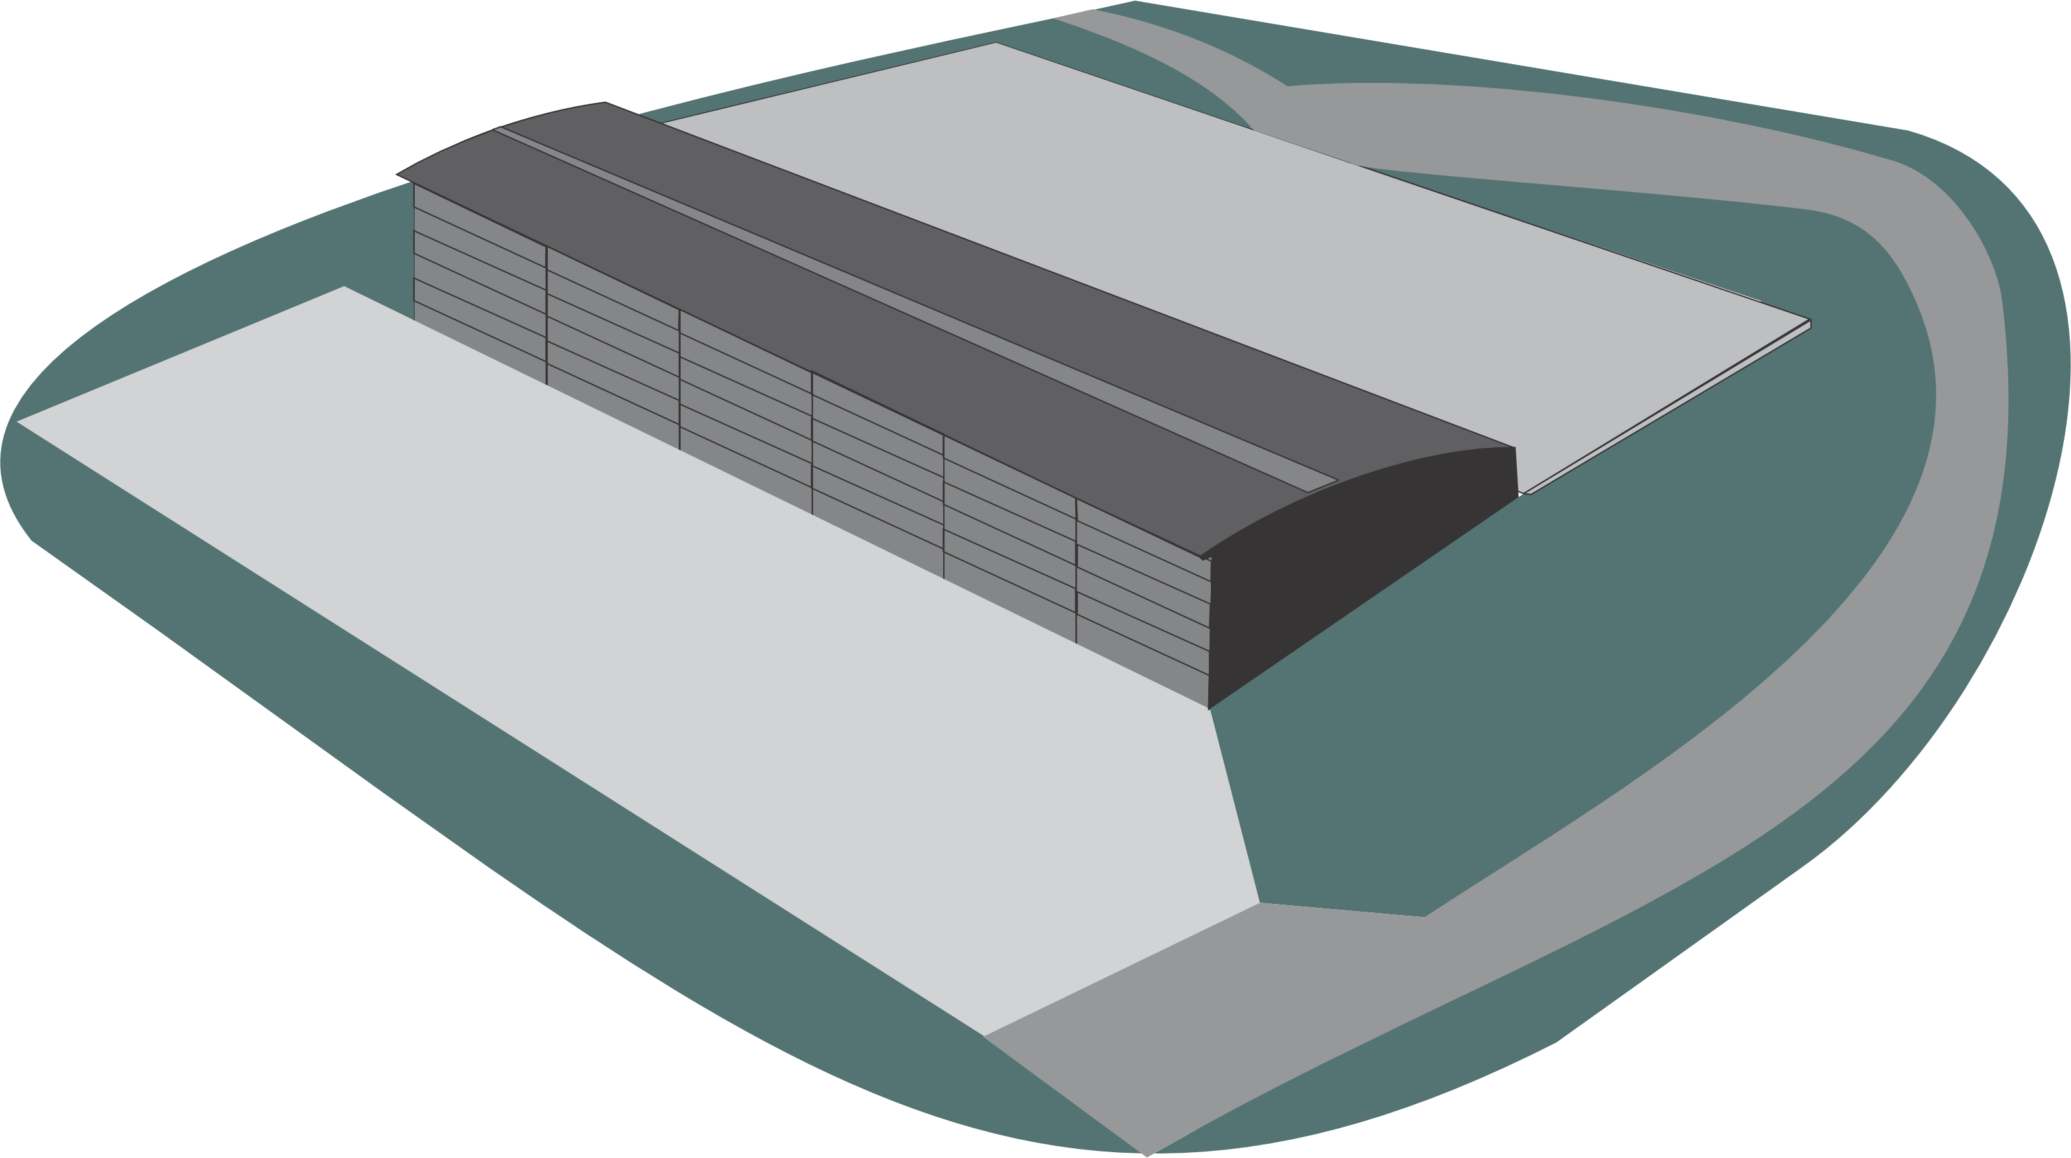
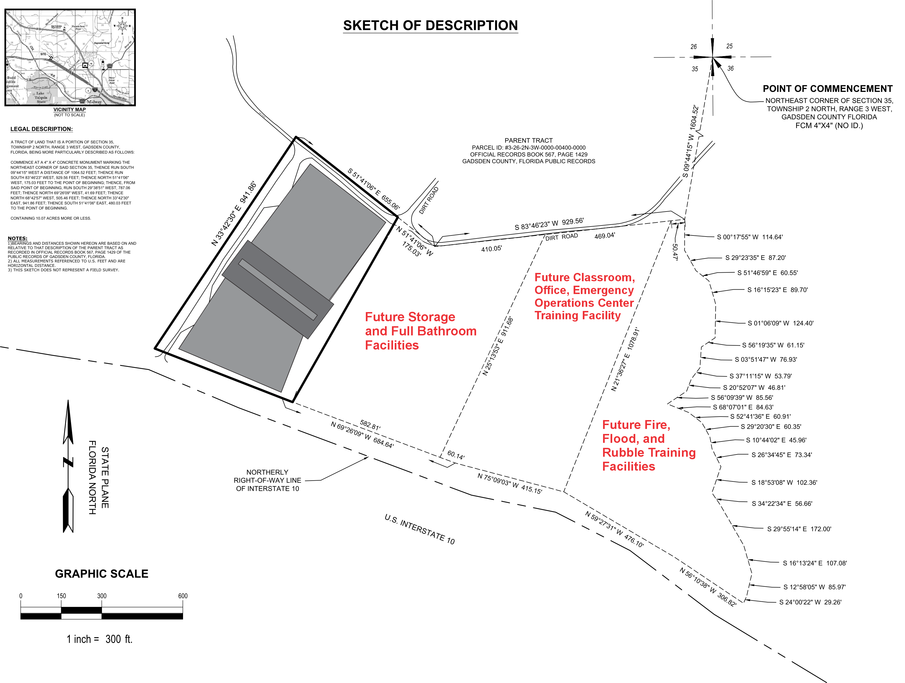

Recommendations
Research the few exemplary program models identified which could serve as templates for improving future programs.
Construct first phase of Florida’s Emergency Management Institute.
FDEM will fund the project through federal disaster preparedness funds.
This will support current TSC Emergency Management AS Degree curriculum to close the gap between degree programs and the EM workforce.

