Slide 1

Kayla Dover
Case Manager

Slide 2

SOAR to the Future: Bridging Education, Support, and Community
Project Description
Emerging Eagles is a program for students who were formerly in the child welfare system. This project focuses on rebuilding and improving the Emerging Eagles Program through three major components: Mentorship through Leadership BRIDGE Conference Partnerships
Rationale:
Data shows that support services targeting former foster youth can help improve retention and graduation rates.
50%
2-6%
Finish high school (NFYI)
Earn a two-year degree (NFYI)
100 - 150
Students using DCF waiver at TSC

Slide 3

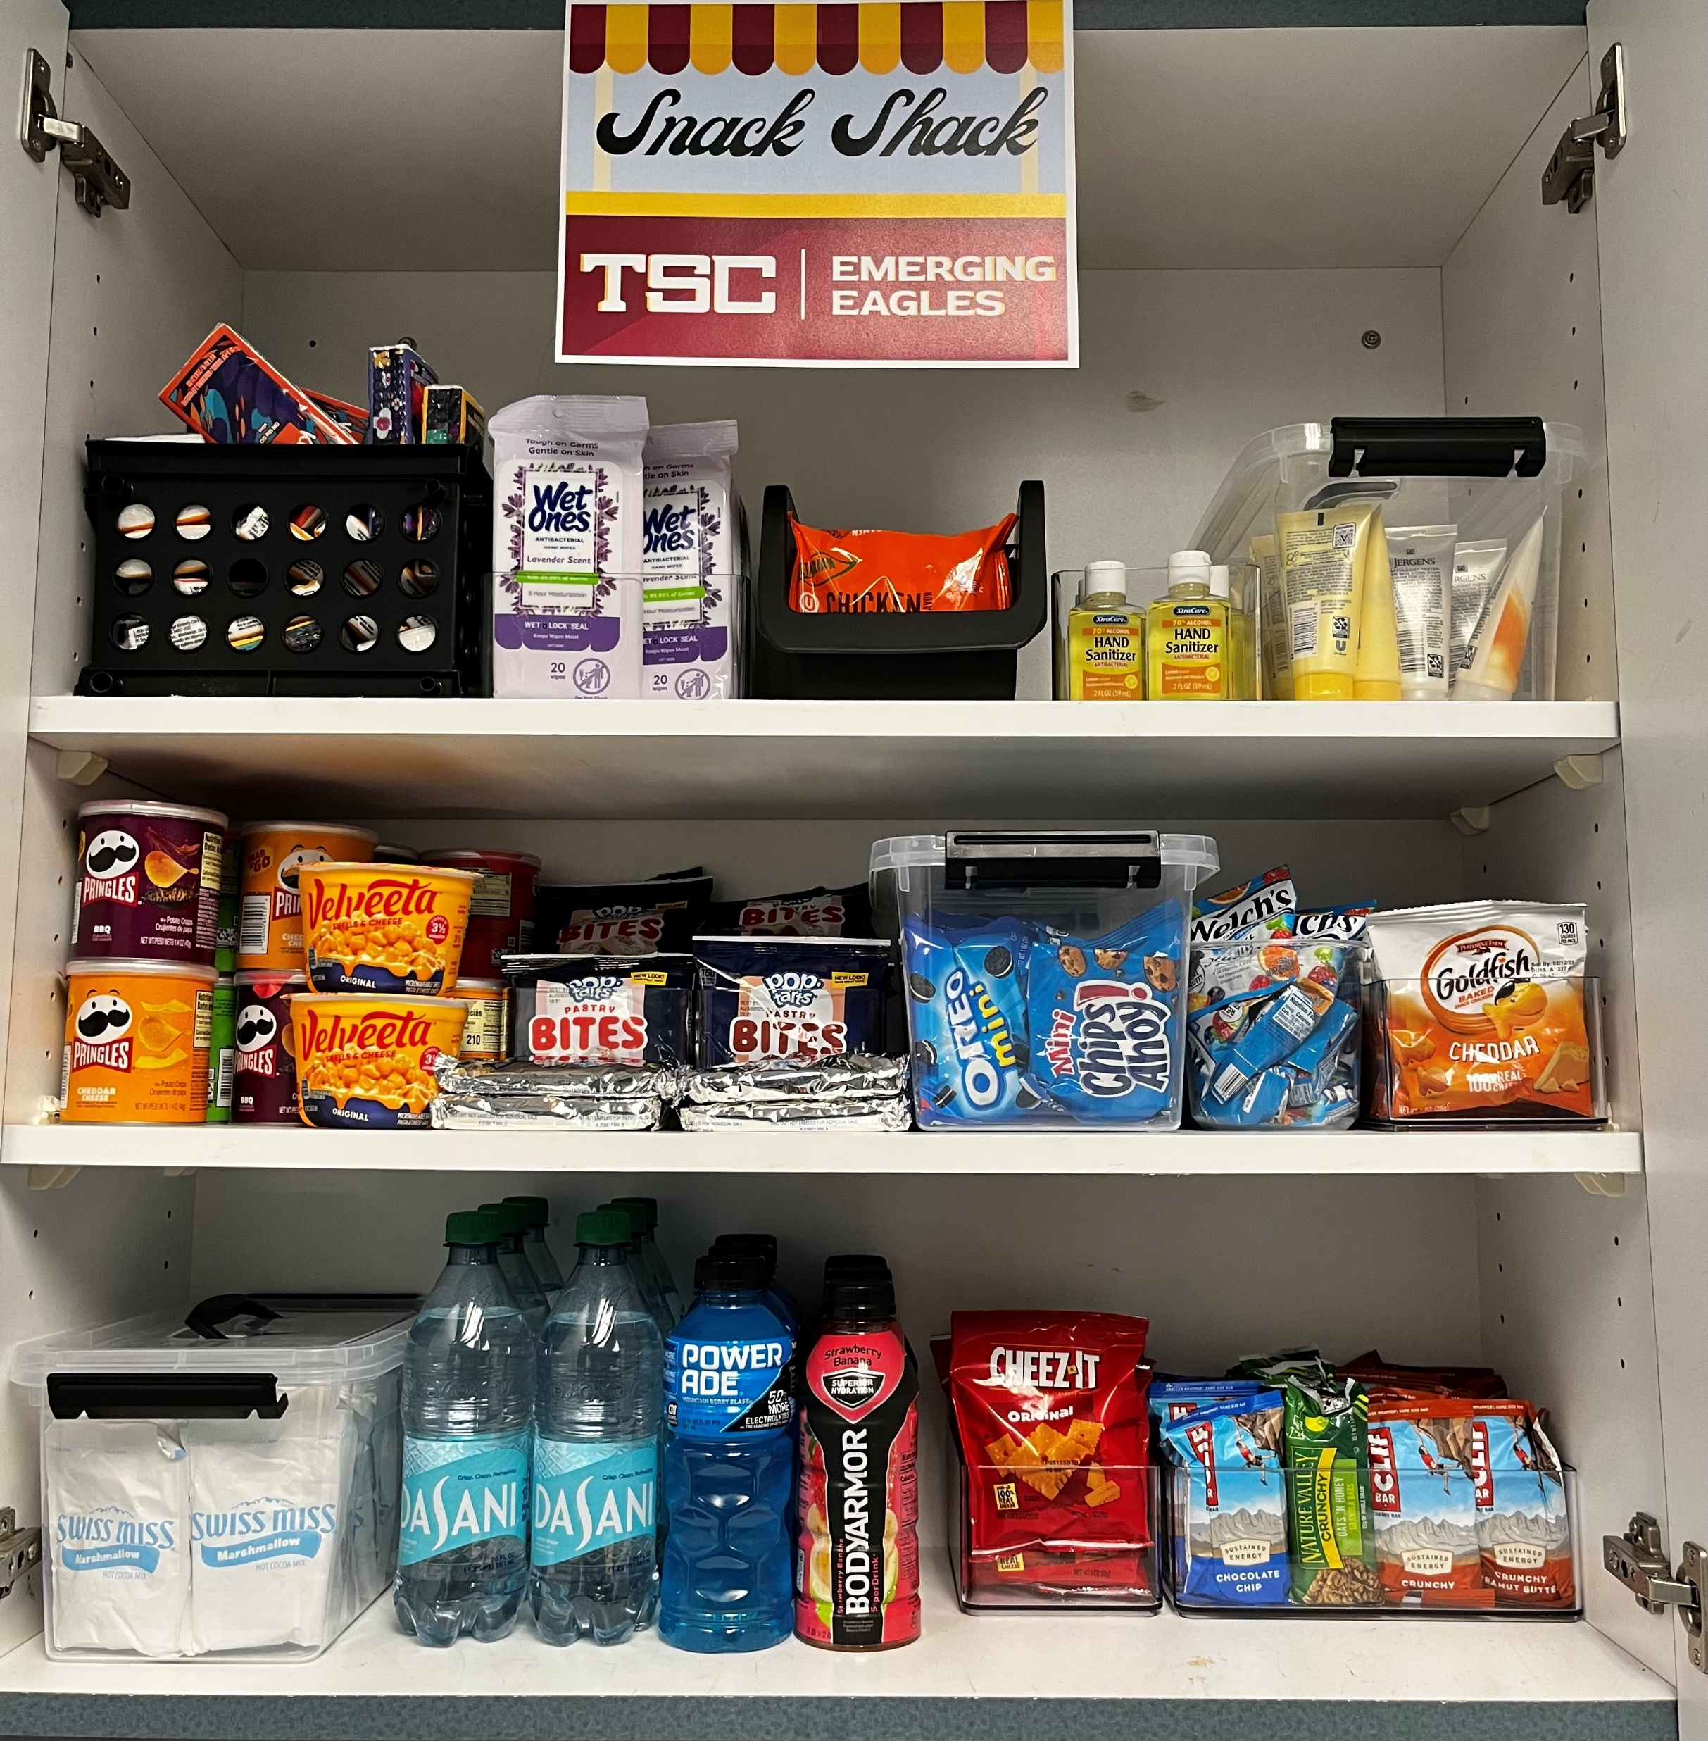

Capstone Results
+ Partnerships
+ Program Visibility
Student Advisory Board
+ Mentorship Opportunities
+ Leadership Experience
+ Program Ownership
+ Program Participation
+ Security & Needs Met

Slide 4
Future Recommendations
Host more life skills workshops
Continue pursuing funding opportunities for program
Leverage community partnerships to increase program participation
STRIVING. OVERCOMING. ACHIEVING. RISING.

