Slide 1

John Salter
Learning Commons Specialist

Slide 2
Capstone Overview
Project Description
Increase the pass rate of college algebra students from 65% by: Incentivizing use of learning commons resources Leveraging AI-adaptive tools and DESMOS technology Fostering persistence through targeted support during critical weeks.
Rationale
Increase Access: Provide flexible, technology-enhanced support for students with diverse needs.
Boost Success Rates: Improve pass rates and comprehension through personalized learning experiences.
Promote Engagement: Make learning interactive and relevant by integrating AI tools.
Reduce Barriers: Use AI to identify and address knowledge gaps in real-time.
Notes:
The focus for this project was to enhance what we are doing in the Learning Commons but specifically the Algebra Corner. While we have a plethora of resources and services for students, our processes and systems could be updated to provide a more seamless experience.
new ways to incentivize students to come to the LC
New ways to use generative technology to enhance student engagement and success
Focus on doing both to assist during critical weeks.

Slide 3
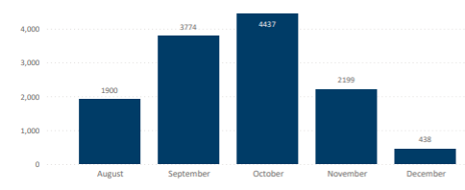
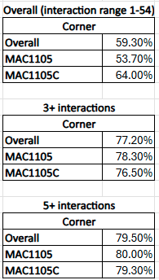
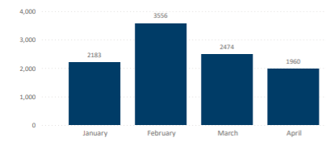
Capstone Results

Slide 4
Future Recommendations
What to do next…
How to do it…
Increased embedded support from other entities on campus (ie Title 3, Champions, and Success Coaches)
Faculty involvement in workshops and reviews
Increased class visits (beginning, middle, and end of semester)
Workshop series on how to use Technology and AI in course work
Monthly Workshop Calendar sent to students
Rebrand as the place to get all questions answered and as the Welcome Center of the College
Work with other divisions and departments to increase student access and support
Improve how we market and communicate to students
Become the center for learning, understanding and using AI for students
Rebrand and market the LC
Notes:
Work with other divisions and departments to increase student access and support from other entities on campus (ie Title 3, Champions, and Success Coaches) and with Faculty involvement in workshops and reviews
Improve how we market and communicate to students by having Increasing class visits and having them prior to critical times and Monthly Workshop Calendar sent to students
Workshop series on how to use Technology and AI in course work Become the center for learning, understanding and using AI
Rebrand and market the LC as the place to get all questions answered and as the Welcome Center of the College

