Slide 1

Jessica Jones
Assistant Professor,
Computer Technology

Slide 2
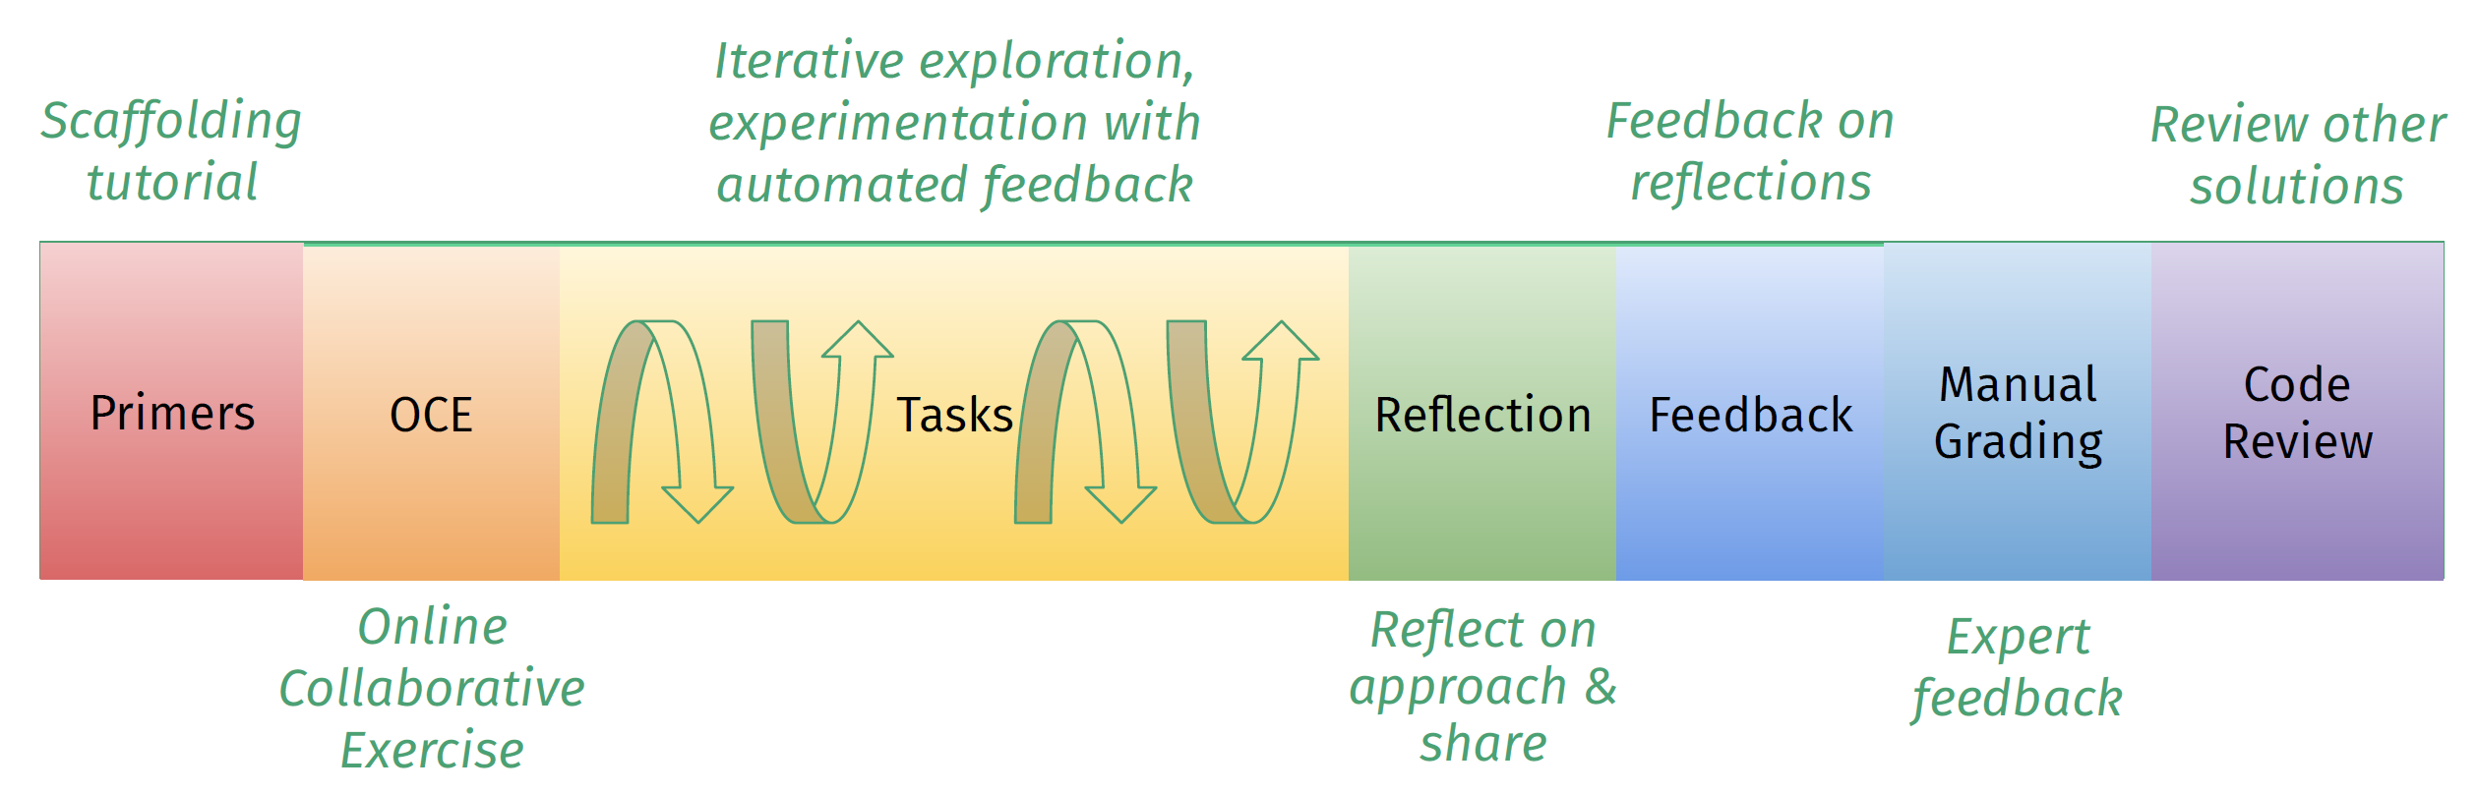
SAIL-CC Project Description
The SAIL-CC (Social And Interactive Learning – Community College) project is a 4-year project funded by the National Science Foundation to develop and deploy entry-level CS/IT curricula with community colleges for community colleges, provide professional development for participating faculty, and conduct learning science research benefiting the greater community.
SAIL delivers CS/IT content in a project-based learning model, with automatic assessment and feedback to faculty and students (scalability).
SAIL provides granular data to instructors to augment their teaching practice and enable research studies.

Slide 3
Capstone Results – Goals and Data
Currently success rates in both courses fluctuates within the 70th percentile
Hope to set a baseline across courses
Better prepare students for networking, cyber security and computer programming
Raise success rates into the 80th percentile

Slide 4
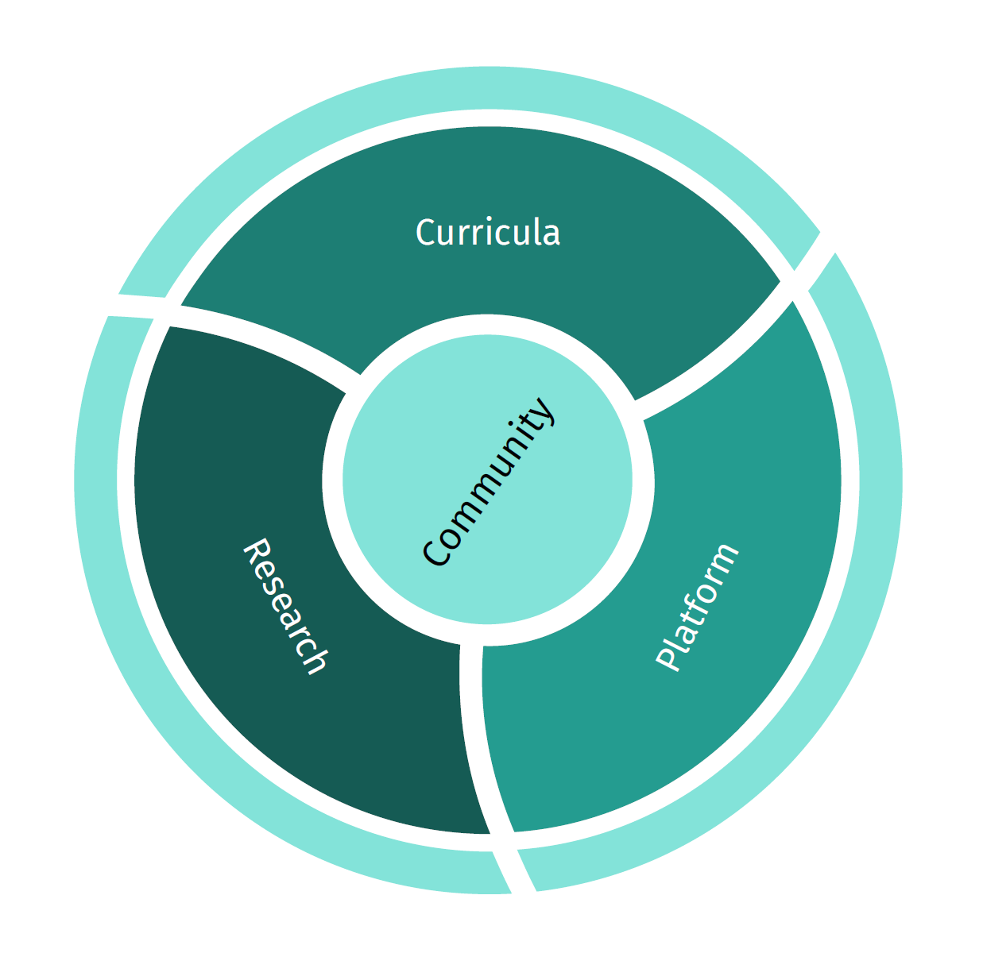
Suggestions for Further Research
Future Actions
Attend professional development workshops provided by Carnegie Mellon University
Pilot the SAIL curricula and platform in FALL 2023
Perform research based on collected data and analytics
Scale SAIL offering across a larger number of adopters

