Slide 1

Human Resources
Heather Marie Mitchell
Training and Development Manager

Slide 2
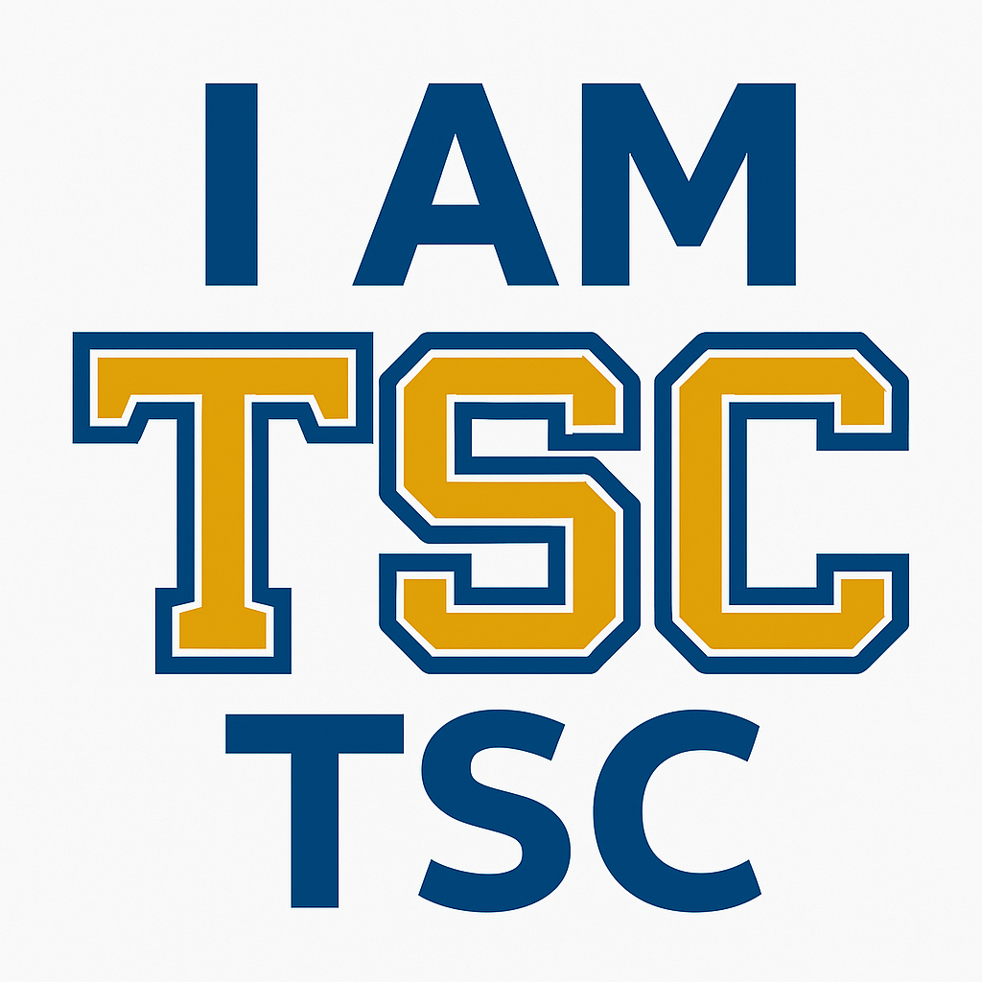
I AM TSC
Strengthening Onboarding, Development, and Retention
Project Description
A strategic initiative designed to build institutional pride, promote employee engagement, and strengthen early retention through structured onboarding and early professional development.
Rationale:
Only 56% of employees reported that onboarding was clear and helpful.
44% felt uncertain about their roles and how to access essential training.
1 in 3 staff members have been with the college for less than a year, compared to 1 in 10 faculty.
Nearly 30% of staff report needing significant development in tools like Excel and Workday.
Soft skills gaps persist - less than half feel highly confident in giving feedback, asking insightful questions, or navigating conflict.
Notes:
At Tallahassee State College, people are our greatest asset-but our data tells us that we’re missing key points to support and retain them early in their journey. This isn’t just a checklist. It’s a culture –builder that prepares employees to thrive, not just start. To address these challenges, the I AM TSC initiative introduces structured onboarding, milestone-based check-ins, and early access to professional development to strengthen connection, confidence, and career alignment.

Slide 3
Capstone Results
What Employees Are Telling US
Clear Onboarding Expectations
Feeling Connected in Early Days
Training Access & Support
Manager Support in Onboarding
Interest in Leadership Development
50% of our employees hold advanced degrees
53% of employees have 5–10+ years of service
Roughly 10% of total staff are new hires annually (based on 100 hires per ~1000 FTE)
Over 10% increase of new hire participation in professional development programs
Over 68% of our 995 LinkedIn Learning licenses are in use

Slide 4
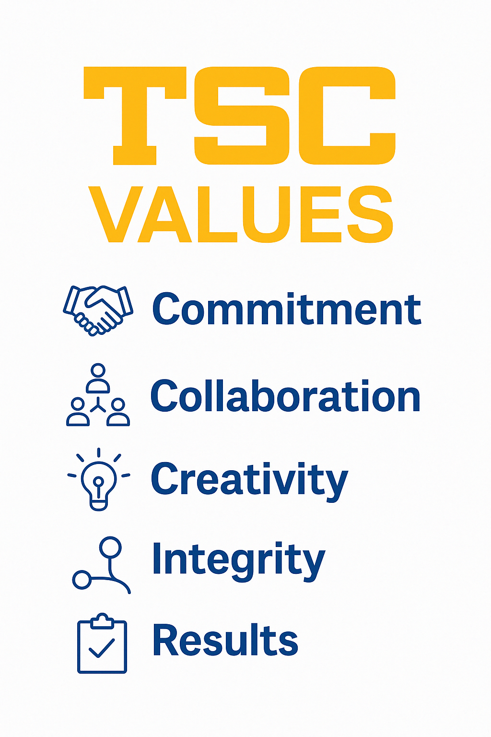
Moving With Intention: Living Our Values
Day 1 -30
Commitment
✔ Orientation checklist
✔ Manager Welcome
✔ Expectations & Guidance
Day 100+
Results
✔ Professional Pathways
✔ Credentialing& certification
✔ SharePoint Access- Ongoing support for long-term success
Day 31-60
Collaboration
✔ One –o-one check ins
✔ TAR Sessions
✔ Departmental engagement
Day 91-100
Integrity
✔ Feedback & Reflection
✔ Survey follow-up
✔ Manager alignment
Day 61-90
Creativity
✔ Coaching sessions
✔ LinkedIn Learning & AI
✔ Personalized Pathways

