Slide 1

Emily Micik
Director, Academic Advising

Slide 2
Academic Advising Satisfaction Survey
Project Description:
Established a baseline for student satisfaction ratings of academic advising services.
Assessment Used:
Collected and analyzed data from student satisfaction surveys over several months.
Key Outcome:
Baseline satisfaction rate: 91.7% Very Satisfied & Extremely Satisfied.
Identified 8.3% of students as Moderately Satisfied, Slightly Satisfied, or Not At All Satisfied for further exploration and improvement efforts.

Slide 3

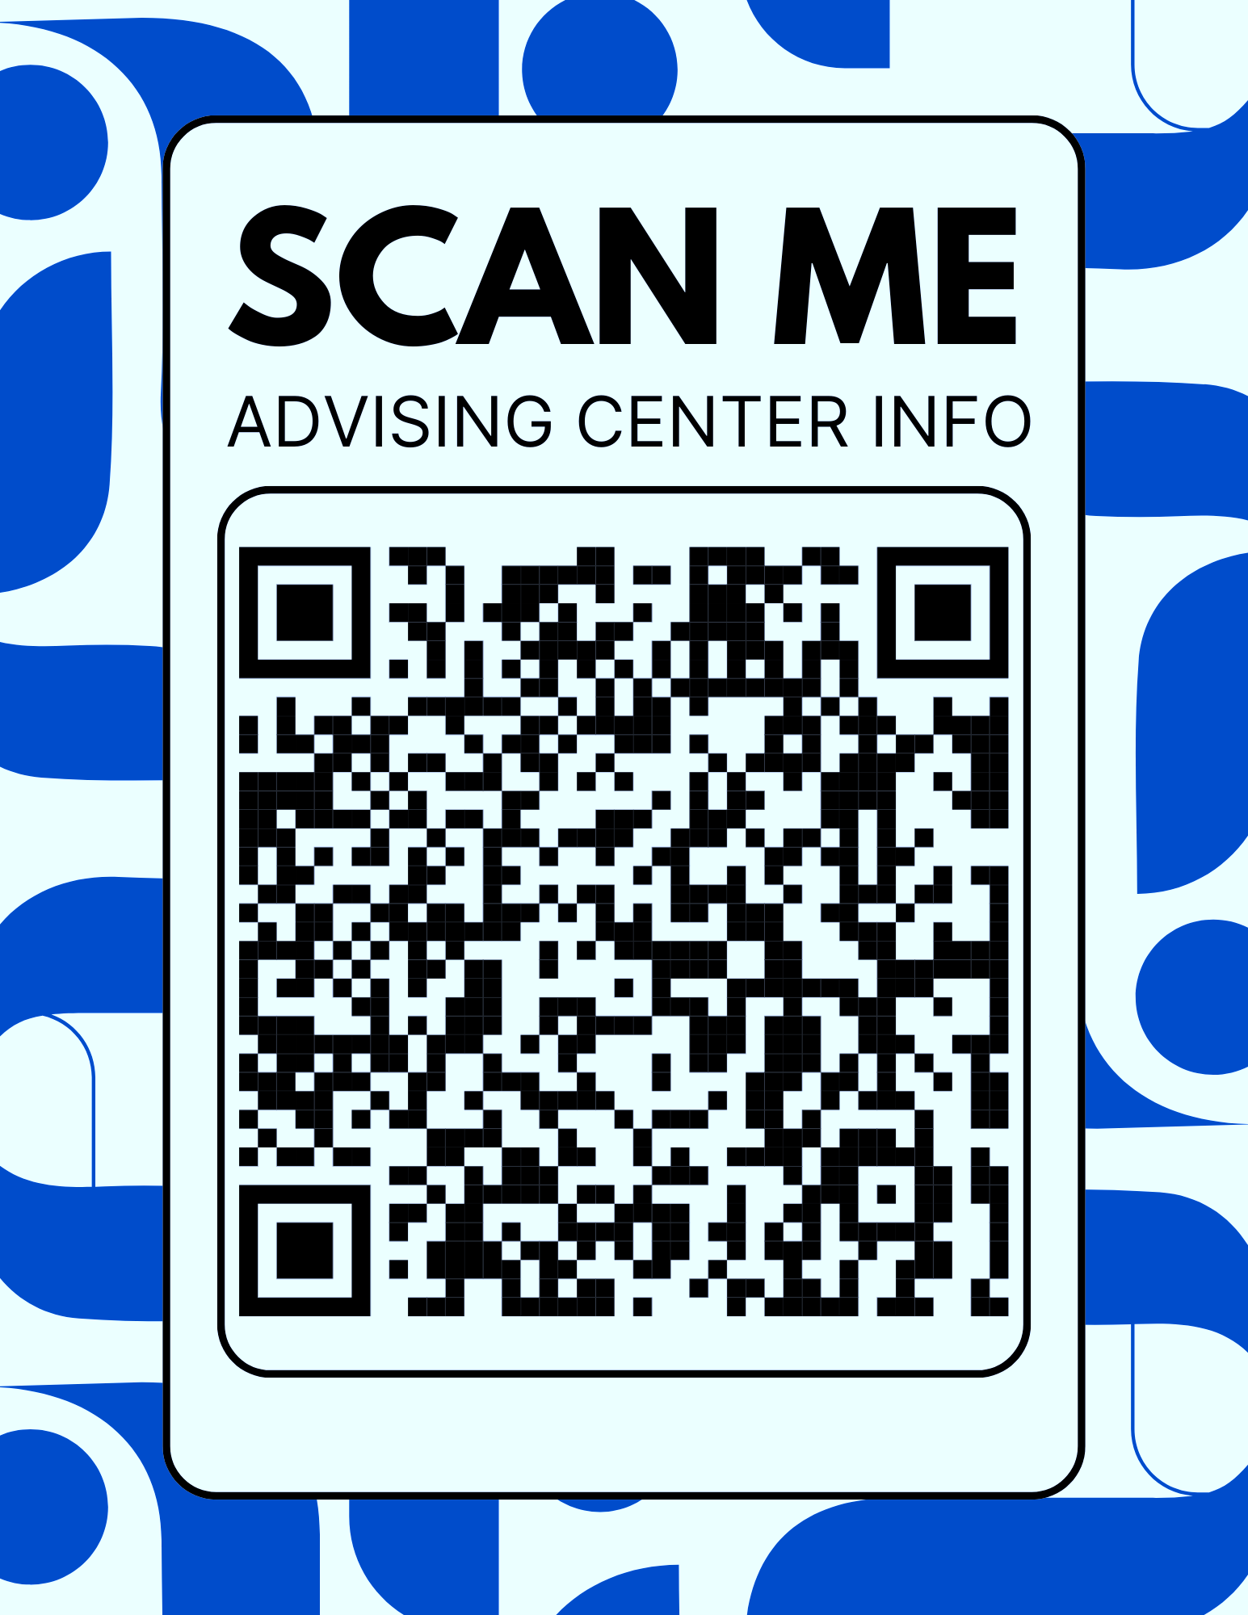
Capstone Results
Formed a Work Group of 5 Academic Advisors.
Reviewed feedback and brainstormed immediate improvements.
Designed and distributed a conversation checklist for advisors.
Key Questions Now Incorporated into Advising Sessions:
“How are you doing in your classes this semester?”
“What is your major? Has it changed since your last advising?”
“Let’s review your current academic progress together.”
“Let's discuss your course selection for next semester.”
“Are you aware of support resources on campus?”
“Did I answer all your questions today?”
“Scan this QR Code so you always have advising resources.”

Slide 4

Future Actions
Ongoing Assessment:
Maintain regular student satisfaction surveys to monitor seasonal trends.
Actively analyze qualitative feedback for actionable insights.
Work Group Engagement:
Continue to empower the established Work Group to review feedback and brainstorm creative solutions.
Focus on All Feedback:
Highlight not just positive feedback, but also neutral and dissatisfied responses to address personal student concerns.
Enhanced Student Voice:
Conduct 2–3 focus groups per year with random student volunteers to facilitate open and honest conversations.
Advisor Collaboration:
Approach advising adjustments as collaborative initiatives, ensuring advisors feel heard and supported.
📈
🧠
🗣️
🤝
Notes:
It is impossible for a regional economy to achieve transformation unless there is a shared regional identity and a shared vision for regional economic growth that all the partners own – both as collective and individual partners. Partners will need to align the strategies and resources of their own organizations and systems to the regional vision.
The development of a regional identity (which is not necessarily a brand, but it can be) and the vision for regional economic growth are critical to sustaining a globally competitive region.
The vision is especially critical to driving new regional behavior and is the touchstone when a region faces challenges – something that is almost guaranteed given the wide array of interests that are represented in a regional economy.
The vision is also the driver for regional strategies and new investments, as well as for alignment of current investments.

