Slide 1
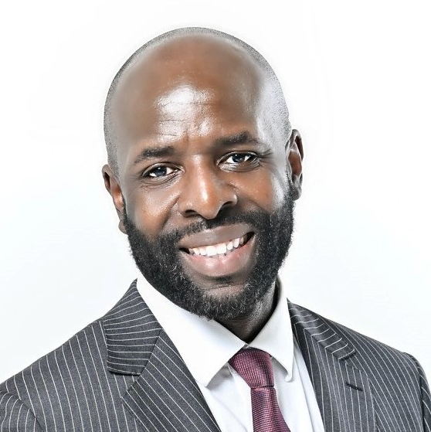
Dr. Gerald Jones
Associate Vice President,
Student Affairs

Slide 2
Onboarding Experience for Minoritized Students
Overview: The purpose of this capstone project is to implement an equitable support design to influence student retention of minoritized students. By hosting a specialized onboarding experience rooted in research and theory will position Tallahassee Community College to meet its goals in closing equity gaps.
      Assessment: Surveys, Focus Groups, Observation, Institutional Research Data

Slide 3
EQUITY IN SUCCESS FOR WHOM

Slide 4
Learning Outcomes
Create
Create a sense of belonging and nurturing.
Understand
Understand success strategies for college completion.
Recognize
Recognize areas for improvement while pursuing academic success.
Explore
Explore the academic success patterns of high achieving minoritized students at the community college.
Notes:
ADD MORE CITATIONS TO THESE SENTENCES

Slide 5

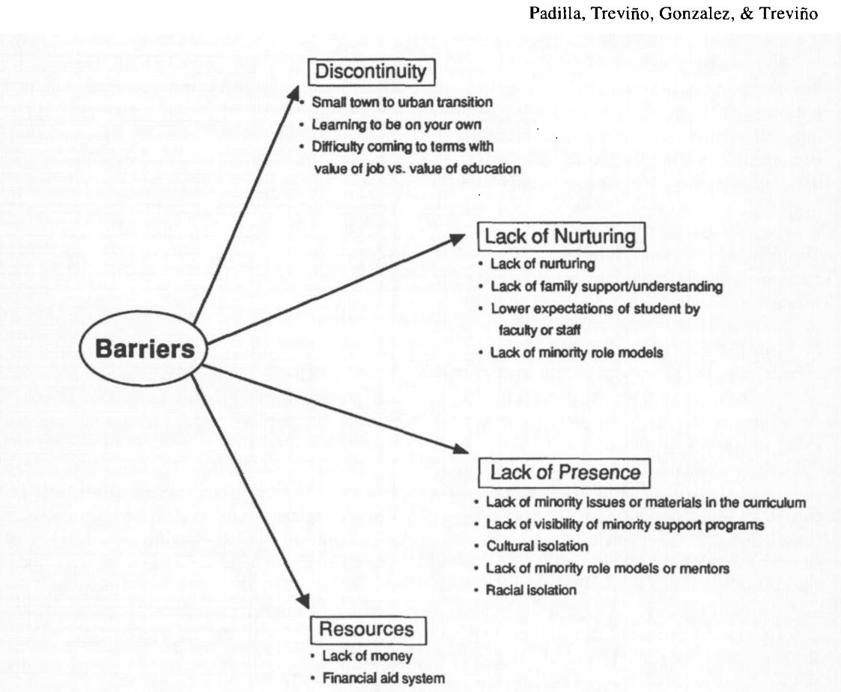
Barriers
(Jones, 2018)
Notes:
ADD CITATION OR MAKE SURE YOU ORALLY MENTION NAME OF AUTHORS
OK SINCE IT IS HERE YOU DO NOT NEED THE TFRAMEWORK IN CHAPTER 1
NO NEED TO REPEAT CHAPTER 2

