Slide 1

Dr. Angelina Kuleshova
Assistant Professor,
Division of Science and Mathematics

Slide 2
Psychologically Attuned Communication
about Academic Warning
Goal: To revise institutional messaging to students about academic warning (AW).
Partners
  Student Affairs
  The Learning Commons
  The College Transition Collaborative, Stanford University

Slide 3
Design Principles of Psychologically Attuned Communication
Frame the AW status as a process and opportunity for learning and growth.
“Moreover, many students at TCC participate in the academic warning process each semester and, by working with their advisor and the academic success coach, as well as accessing campus resources, students leave the process and continue on to have a successful career at TCC.”
Normalize student difficulties in college.
Emphasize belief in student’s potential to succeed and return to good standing.
“There are many reasons students may experience academic difficulties, including those related to physical health, mental health, finances, personal relationships, and others. ”
Acknowledge a variety of factors that contribute to student difficulties.
Brady (2020)

Slide 4
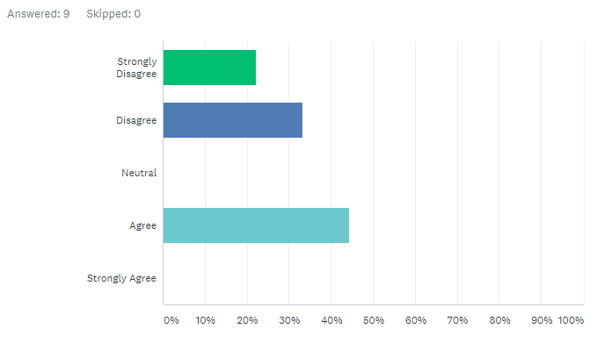
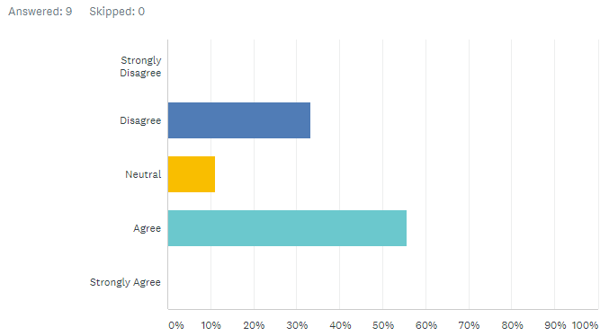
“After reading the letter, I feel hopeful.”
Current Letter
Revised Letter

Slide 5
Why does ‘psychological attunement’ of AW messaging matter?
Subtle differences in how we communicate to students can change the meaning they make about whether they belong, are capable of succeeding, and are valued.
Potential to help traditionally marginalized or under-represented students.
Brady (2020)

Slide 6
Why does ‘psychological attunement’ of AW messaging matter?
Improving AW outcomes will help advance equity goals at TCC.
Notes:
10% of the TCC population; only 26% of 1082 were enrolled this Spring students; 63% of the 1082 were New Students

