Slide 1
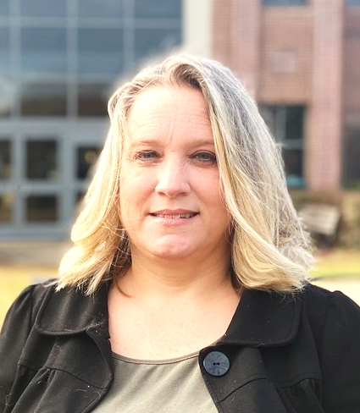
Desiree Gorman
Director, Special Projects and Innovation, Workforce Development

Slide 2
Capstone Focus
Capstone Overview
Project Description:
TCC2Work – “Skills Guarantee”
Students currently enrolled in a Workforce Development CTC program will be matched with a corresponding department within the College to participate in “Work Days” on a set basis (weekly/bi-weekly, etc..) to gain hands-on experience, introduction to the labor force and job-related training.
Rationale (the WHY):
The concept is built similar to an On-The-Job Training program; however, the distinction in the program is that “work” is embedded at the onset which will provide our students with a competitive edge when seeking employment. It affords TCC the opportunity to assume an active role in providing “real world” experiences.

Slide 3
Pending! The program kicked off this week with our first student participant in Information Technology.
The goal will be to provide staffing support in the areas identified while also addressing the hard and soft skills being requested by local employers.
Capstone Results

Slide 4
SUGGESTIONS FOR FURTHER RESEARCH
Suggestions for Further Research
Do students who are exposed to real world skill building opportunities throughout their training experience achieve a greater success rate in gaining and maintaining employment after completion?
Graduates will be provided a skills guarantee letter to put in their portfolio to prospective employers. A sample group of graduate employers will be surveyed at the 30/90/180 market to determine if the skills they did learn has adequately prepared them for the job.

