Slide 1
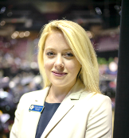
Candice Grause
Vice President of Communications and Chief of Staff

Slide 2
Capstone Focus
Capstone Overview
Project Description:
Prosperity 32304 is a special community initiative designed to build a network of relationships and a portfolio of promising practices around the root causes of poverty that are designed to positively impact the economic well-being of those who live in the ZIP Code 32304
Rationale:
Mission Focus
Top Employer
Location

Slide 3
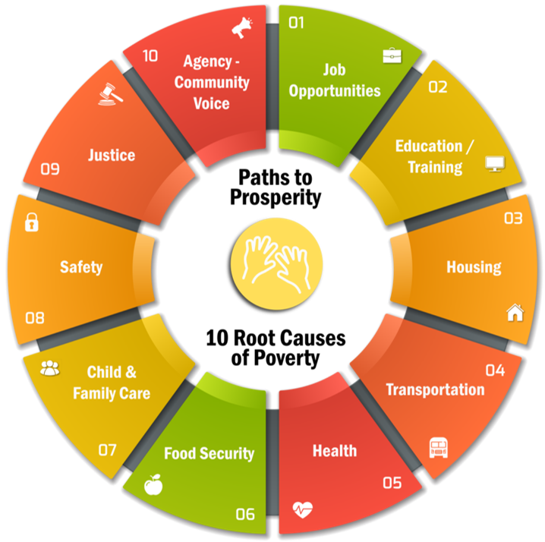
Capstone Results
Collected promising practices and data
Held a meeting of the network
Drilled down to census tract to focus on neighborhoods
Focused TCC’s education efforts, and collectively realized a 35% increase in enrollment over the last two years
Census Tract​ | 6​ | 14.01​ | 20.03​
Neighborhood​ | Frenchtown​ | Griffin Heights​ | TCC​
Persons Living Below the Poverty Line​ | 61.5%​ | 53.3%​ | 64.2%​
Children in Poverty​ | 61%​ | 48%​ | 42%​
Median Age​ | 33.2​ | 42.1​ | 32.5​

Slide 4
Suggestions for Further Research
Continue to collect promising practices
Monitor outcomes
Conduct a deliberative forum with local residents
Create a framework to be shared

