Slide 1

Caitlin Bradbury
Digital Communications Specialist

Slide 2
Capstone Project
Project Description
Do Students Know How to Apply?
Rationale:
Students don’t know ______
Finding the page
Reading the page
Process:
What were we doing?
What are other colleges doing?
Who can help?

Slide 3
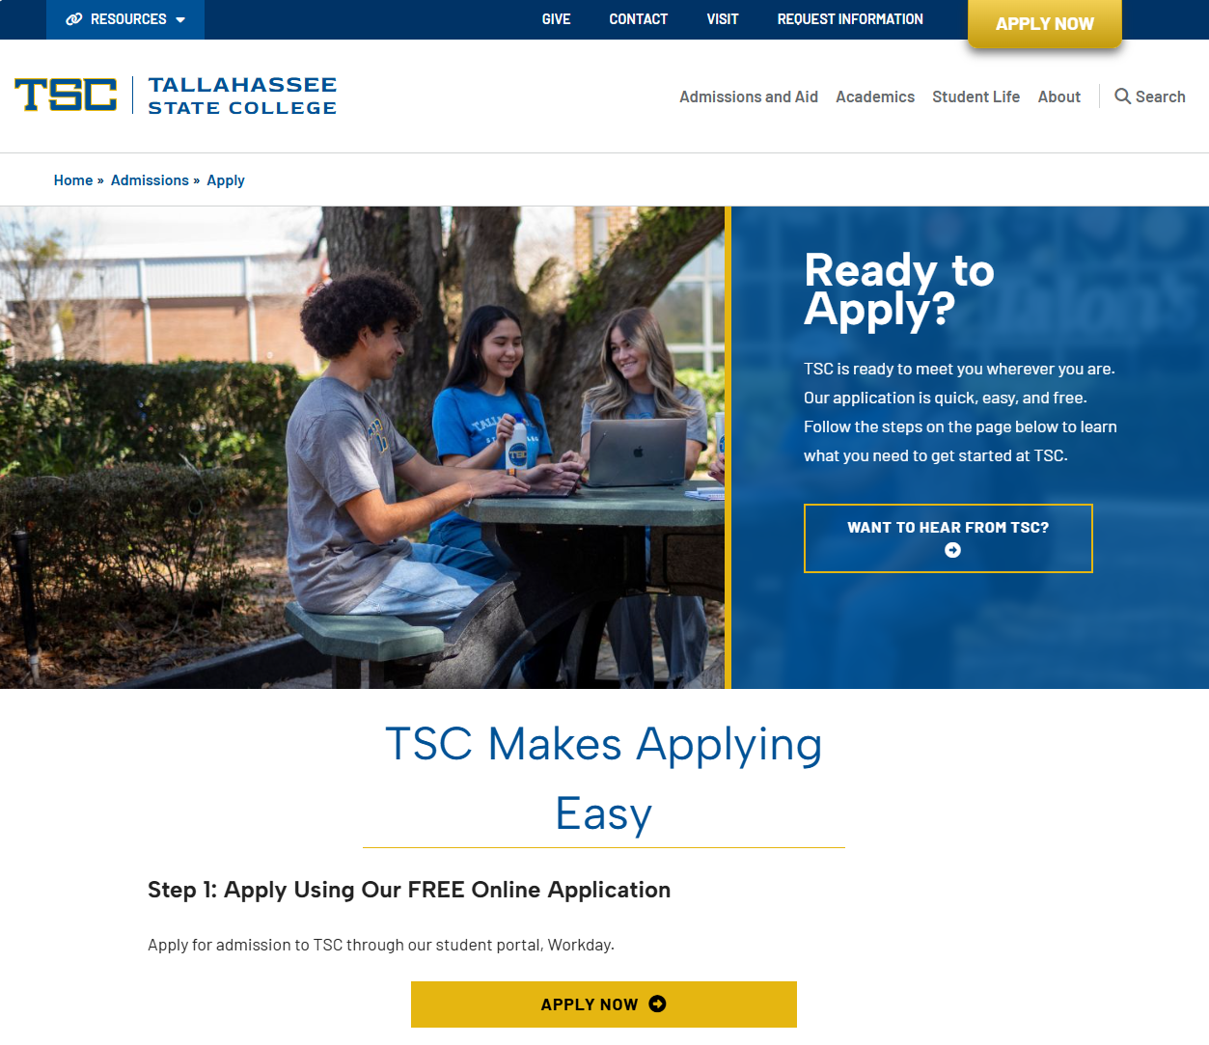
Capstone Results
www.tsc.fl.edu/apply
Results:
1 Page - 1 Click
7th Grade reading level
9 Steps
Future Recommendations:
Monitor student response
Continue addressing pain points

