Slide 1

Brielle Crooms
Executive Assistant
Office of the Provost and Academic Affairs

Slide 2

Overview
Purpose: Outreach to unenrolled FTIC students with a GPA of 2.0 or higher.
Each student exemplifies the following:
  Not registered during the 2020-2021 Academic Year.
  Have not earned a degree or certificate at TCC .
  Did not transfer to another postsecondary institution.

Slide 3
Analysis
Identified by matching data with the National Student Clearinghouse.
Fall FTIC Cohorts:
  2018 | 837 Students
  2019 | 295 Students
  2020 | 409 Students
  Phases to Contact Students:
  Phase 1: 4.00 GPA
  Phase 2: 3.25 – 3.99 GPA
  Phase 3: 2.75 – 3.24 GPA
  Phase 4: 2.00 – 2.74 GPA

Slide 4

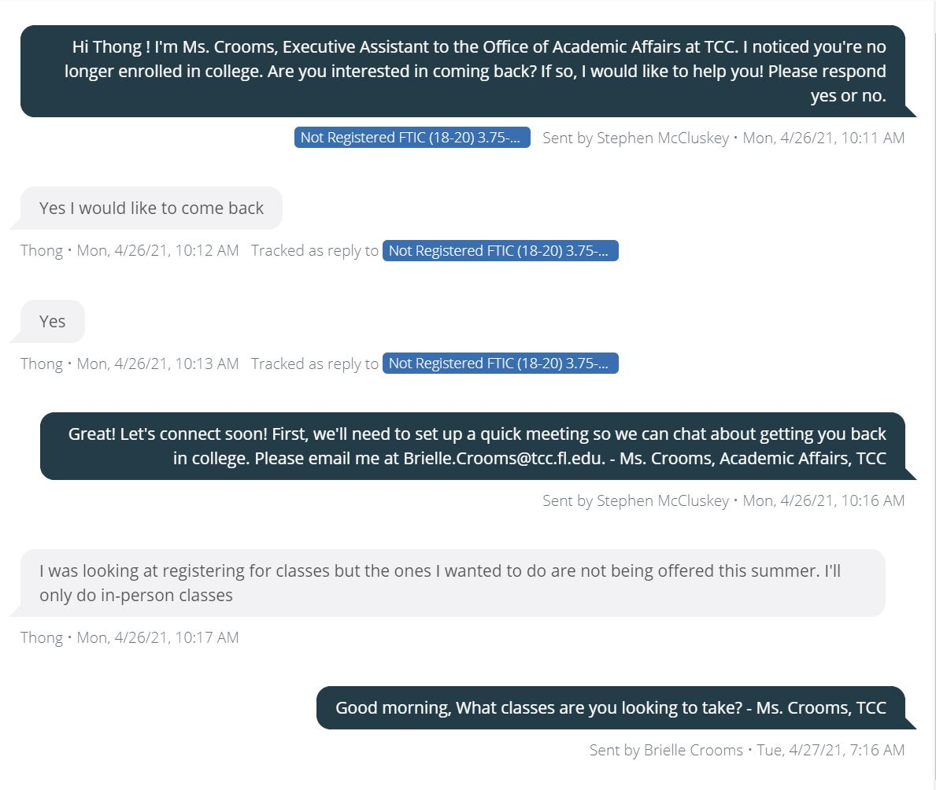
Outreach
Incremental Text Messages to students based on GPA:
  April 14 | Phase 1
  May 10 | Phase 2
  May 25 | Phase 3
  June 07 | Phase 4
Next Steps:
  One-on-One Meeting with Students
    Mapping Out a Plan
    Creating Steps to Return

