Slide 1

Brendie Hawkins
Director, Grants and Special Projects, TSC Foundation

Slide 2
The Nexus of Education, Food and Technology
Combatting Food Insecurity within Our Community
Rationale:
Expand support for Talon’s Market
Develop community food production education and skills
Leverage technology for producing food at scale
Engage community stakeholders
This project seeks to combat food insecurity through combining food production education, local entrepreneur expertise and AI-enabled technology to create the Greenhouse of the Future.
Notes:
24-25 Academic Year – (specific time frame was August –March) Talon’s Market served 1,188 students, with support extended to 3,213 total people.
During WWII the government encouraged practical self-reliance in the form of Victory Gardens. Conceptually, a technology driven greenhouse, and the re-connection it may establish between the community and healthy, fresh food, is one and the same.
Within the TSC service district, according to the 2022 USDA NASS Survey, Leon County has increased the number of farms to 372 but decreased the amount of land allocated to farming by 24% in just 5 years. Gadsden county saw a loss of 6% of farms during the same period. Only Wakulla saw growth in farms, increasing the number of farms within the county by 22%.
A survey was sent to approximately 120 stakeholders: TSC Leadership, Graduates/Participants in Urban and Small Plot Farming program, and local food producers affiliated through the Red Hills Online Market. Approximately 35% of survey recipients responded.

Slide 3
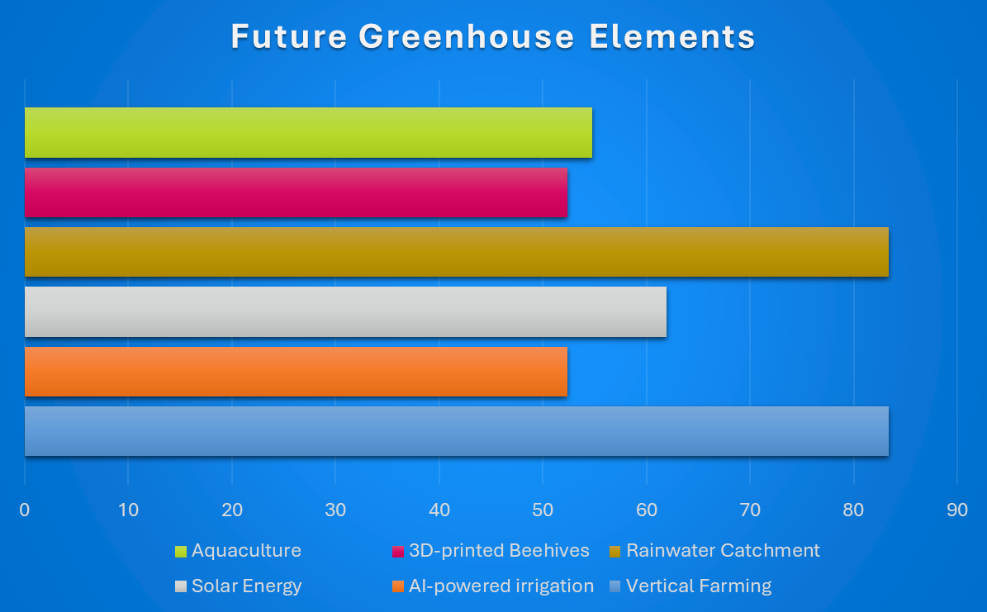
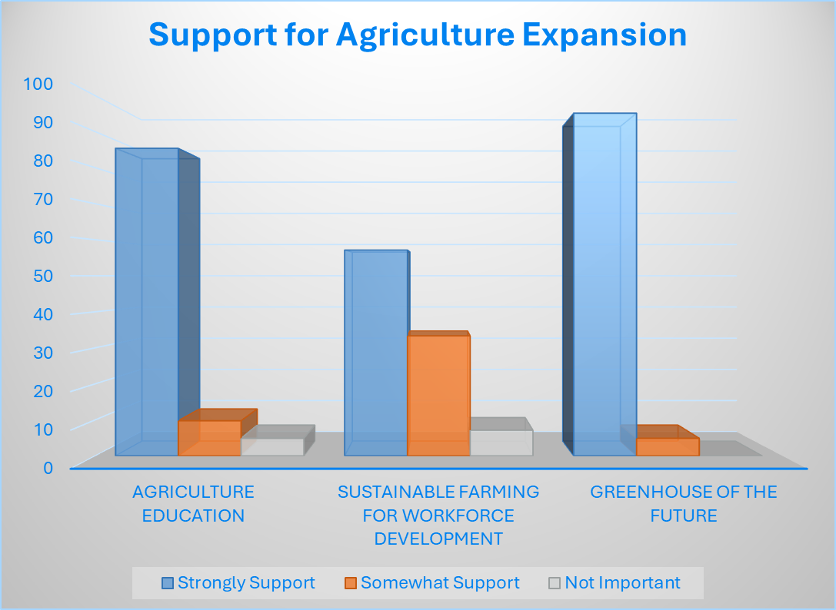
Capstone Results
Notes:
Link to Prosperity 32304
Results of the Combatting Food Insecurity survey

Slide 4
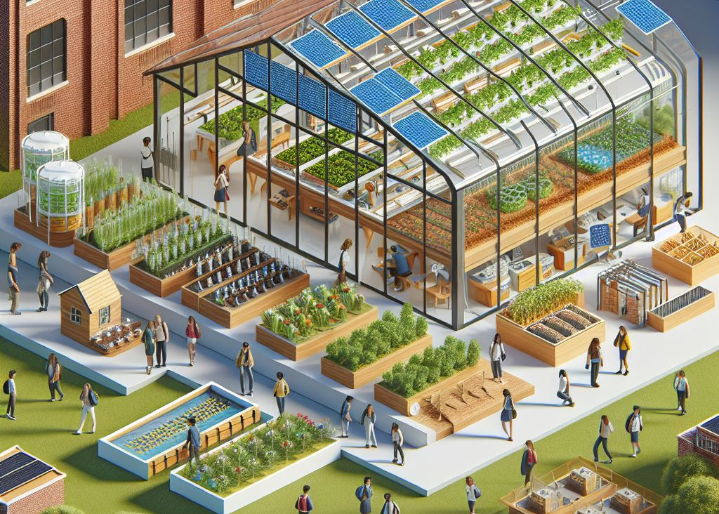
Future Recommendations
Build the Greenhouse of the Future
Create the TSC Future Ready Agriculture Workgroup
Leverage local agriculture entrepreneurs and institutional expertise
Pursue funding for construction/renovation
Notes:
If you build it, they will come.

