Slide 1
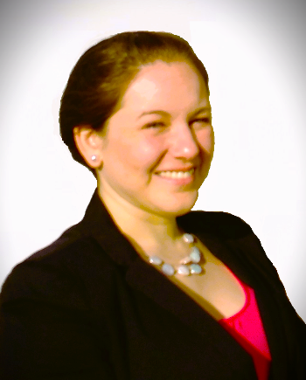
Andrea Arce-Trigatti
Director, Assessment and Accreditation

Slide 2

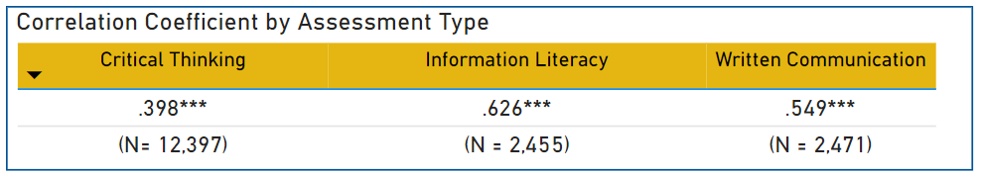
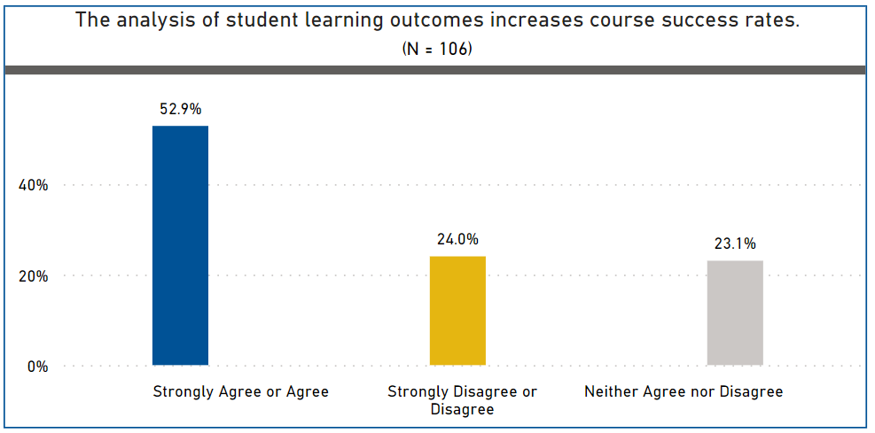
Capstone Focus
Capstone Overview
Title: Examining Practical and Institutional Motivations that Foster Connections
between Student Learning Outcomes and Course Success Rates
Project Description
Rationale
Research Questions:
Are there disciplinary differences present in the relationship between student learning outcomes assessment and course success rates it relates to primary gateway courses?
How do faculty from different disciplines perceive the relationship between student learning outcomes assessment and course success rates on campus?

Slide 3
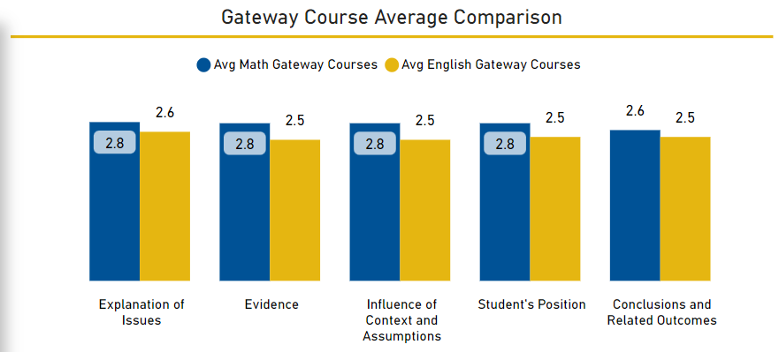
Capstone Focus
Capstone Results
Methodology: Student Learning Outcome and Course Success Data (N = 12,397), Fall 2021, Critical Thinking SLO, Gateway Courses; Faculty Survey Responses (N = 106), Fall 2022 semester

Slide 4
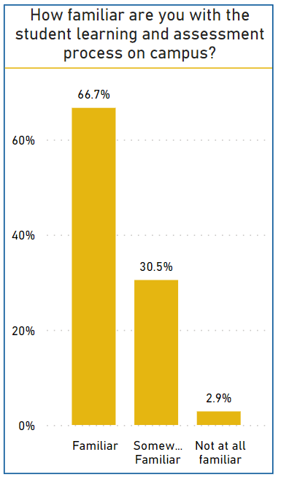
Capstone Focus
Capstone Overview
Title: Examining Practical and Institutional Motivations that Foster Connections
between Student Learning Outcomes and Course Success Rates
Key Objectives
Implications
•Gain a better understanding of faculty perceptions of this relationship by disciplinary focus
•Provide practical applications for supporting positive trends that relate to effective teaching and learning practices on campus.
Debriefing
High Impact Practice Initiatives and Professional Development
Addressing familiarity issues
Alignment with potential funding sources

